Slide 1
🏛️
Soviet Moldavia
Central claim: The USSR cannot be understood only as a multinational federation. In the Moldavian case, political control, symbolic domination, linguistic hierarchy, and unequal elite access made Soviet rule function in important ways like an empire.

Slide 2
Agenda
Presentation map
01
02
Theory
Historical setup
How Cașu places Moldova within debates on empire, federalism, affirmative action, and Soviet nationality policy.
1812 annexation, the MASSR experiment, 1940 border changes, and early Soviet distrust of Bessarabia.
03
04
Discrimination
Late Soviet crisis
Cadres policy, industry, language, symbolic culture, and unequal access to power in the Moldavian SSR.
Language laws, Russian-speaking resistance, Transnistria, and why imperial patterns mattered in 1989–1991.

Slide 3
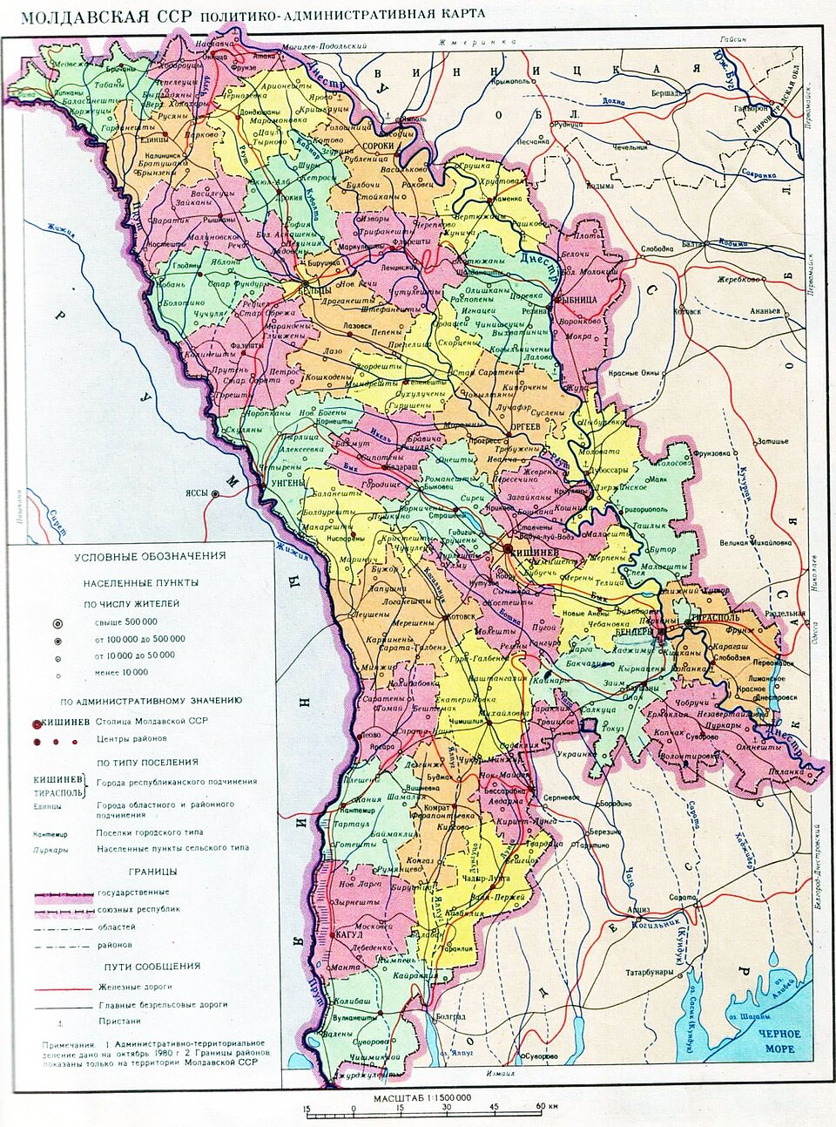

Slide 4
Argument
Why the USSR can be read as an empire
Collapse and nationality: Cașu starts from the argument that nationality policy and imperial structure were central to the Soviet collapse.
Affirmative action empire: Leninist-Stalinist rule built nations institutionally, but only within boundaries tightly managed by the center.
Two-track rights: Non-Russians had cultural rights mainly in their own titular territory, while Russians enjoyed linguistic privilege everywhere in the USSR.
Empire as domination: Even without calling itself an empire, the Soviet state exercised non-consensual rule typical of imperial systems.

Slide 5
Long background
Moldova before 1940
1812
1918
1924 MASSR
Russia annexed eastern Moldavia and renamed it Bessarabia, despite the overwhelmingly Romanian character of the local population.
Sfatul Țării voted union with Romania, but Moscow refused to recognize Romanian sovereignty over Bessarabia.
The Moldavian ASSR was created across the Dniester as a geopolitical and ideological tool for claiming Bessarabia back.
MASSR as a laboratory where Soviet foreign policy, nationality engineering, and anti-Romanian propaganda converged.

Slide 6
Soviet nation-building
The Moldavian identity experiment
1924–1932
1932–1938
Soviet authorities tried to construct a separate Moldavian language using Cyrillic and a heavily Russified vernacular distinct from standard Romanian.
The experiment partially reversed: Latin script returned and the language was made closer to Romanian before Stalinist terror destroyed many of its architects.
The point was not merely cultural. By inventing a Moldavian nation distinct from Romanians, Moscow gave itself an anti-imperial justification for future expansion into Bessarabia.

Slide 7
1940
Occupation, partition, and republic-building
Step
Official claim
Political reality
Effect
June 1940 ultimatum
Bessarabia allegedly had a Ukrainian majority.
The formula helped justify Soviet seizure and later partition.
Ukraine gained northern and southern districts.
Moldavian SSR formed
Union of Bessarabia with part of the MASSR.
Frontiers were drawn from above, not by local consent.
A smaller republic under tighter central leverage.
Cadres policy
Building socialism with loyal personnel.
Bessarabians were distrusted; Transnistrians and Slavs were preferred.
Early administration felt openly colonial.
Language and institutions
National form under socialism.
Russian dominance arrived immediately.
Romanian-speaking elites were marginalized from power.

Slide 8
Stalinism
Violence made the imperial order stick
3
60,000
300,000+
Mass deportations
Forced deportees
Victims overall
June 1941, July 1949, and May 1951.
Directly displaced in the three main operations.
broad estimate for Stalinist violence in Soviet Moldavia, including famine and repression.
Stalinist terror struck multiple ethnic groups, but after Stalin political repression fell disproportionately on ethnic Romanians expressing local or Romanian national identity.

Slide 9
Economy
Investment without equality
But dependency remained
Regional skew
No simple extraction story
Transnistria got about 30% of total republican investment while holding less than 10% of territory and population.
Moldavia often received substantial all-union investment and could not be described as a classic underfunded colony.
Industrialization was coupled with sending more Russian and Ukrainian specialists into the republic and redirecting locals outward.
Imperialism in the Soviet case was not only about economic drain. It was also about who controlled investment, who staffed the new sectors, and which regions became strategic favorites.

Slide 10
Discrimination metrics
Where ethnic Romanians were underrepresented
2.3%
8.6%
25%
80%
Industrial managers, 1964
Industrial managers, 1984
Urban dwellers who were Romanian, 1989
Urbanization of Russians
Ethnic Romanians among industrial managers, 1964
2.3%
Ethnic Romanians among industrial managers, 1984
8.6%
Ethnic Romanians in urban population, 1989
25%
Urbanization of Russians
80%

Slide 11
Political elites
Access to power lagged behind demographics
Position / metric
Trend
Meaning
Communist nomenklatura
Ethnic Romanians rose from about 10% in early 1950s to 54% in 1987.
Representation improved, but key commanding posts stayed tightly controlled.
First Secretary of Moldavian CP
First Bessarabian Romanian only in November 1989: Petru Lucinschi.
The top party post remained off limits almost until the end of the USSR.
Second Secretary
Usually ethnic Russians; first Romanian only in 1989.
Cadres policy stayed under central supervision.
Interior / KGB
Normally non-Romanians or highly Russified Transnistrians; local Romanians arrived only in 1990.
Coercive institutions were last to decolonize.

Slide 12
Language and symbols
Romanian was tolerated, but subordinated
Official bilingualism, real hierarchy
Cyrillic as barrier
The Cyrillic script marked difference from Romania and helped limit direct cultural circulation across the Prut. Demands for Latin script could bring surveillance, marginalization, or psychiatric repression.
Books and newspapers existed in “Moldavian,” but Russian dominated government, higher education, mass media, and public prestige. Romanian stayed strongest in villages and folklore.
Even safe symbolic gestures, such as honoring Eminescu or defending the Stephen the Great monument, could be treated by the KGB as signs of local nationalism or anti-Russian sentiment.

Slide 13
Late Soviet crisis
1989–1991: empire under pressure
Language laws
Industrial tensions
Secessionist leverage
Romanian in Latin script became official. Russian-speakers often read this not as equalization, but as loss of a formerly privileged status.
New all-union projects in Chișinău meant more incoming cadres from the center, deepening fears of demographic and political displacement.
Cașu argues Moscow encouraged Gagauz and Transnistrian separatism to discipline Moldovan independence and block possible union with Romania.

Slide 14
Key quotation
The “big brother” diagnosis
“We are having the psychology of the ‘Big brother’ that should guide, but is not obliged to take into account the opinion of the ‘Smaller brother,’ much less learn his language, history and culture.”
1989 reflection by the Russian journalist Evghenia Solomonova to capture the everyday imperial mentality behind formal Soviet internationalism.
The quotation matters because it shifts the discussion from abstract structures to lived hierarchy: who had to adapt, who did not, and whose language counted in public life.

Slide 15
📚
Conclusion
Empire without the name
Soviet Moldavia was not a classic overseas colony, yet the USSR functioned imperially through coercion, unequal representation, language hierarchy, symbolic control, and divide-and-rule politics. From Chișinău, the empire was visible above all in who ruled, who advanced, and whose identity remained suspect.

