Slide 1
Russian Bessarabia
From the 1812 annexation to the eve of the First World War: autonomy, colonization, Russification, urban change, and the politics of identity east of the Prut.
Central arc: Bessarabia entered the Russian Empire as a largely Romanian-speaking frontier province, gained short-lived autonomy, then experienced colonization, administrative centralization, and uneven Russification that transformed society without fully erasing Romanian language and memory.

Slide 2
Structure
01
02
Annexation and autonomy
Demographic change
1812, boyar elites, the 1818 statute, and why Bessarabia initially received exceptional status within the empire.
Colonization by Russians, Ukrainians, Bulgarians, Gagauz, Germans, Jews, and others reshaped the province.
03
04
Language and church
Economy and politics
The rise and rollback of Romanian in schools, administration, publishing, and Orthodox life.
Agriculture, underdevelopment, Chişinău, the 1903 pogrom, and the emergence of modern national politics.

Slide 3
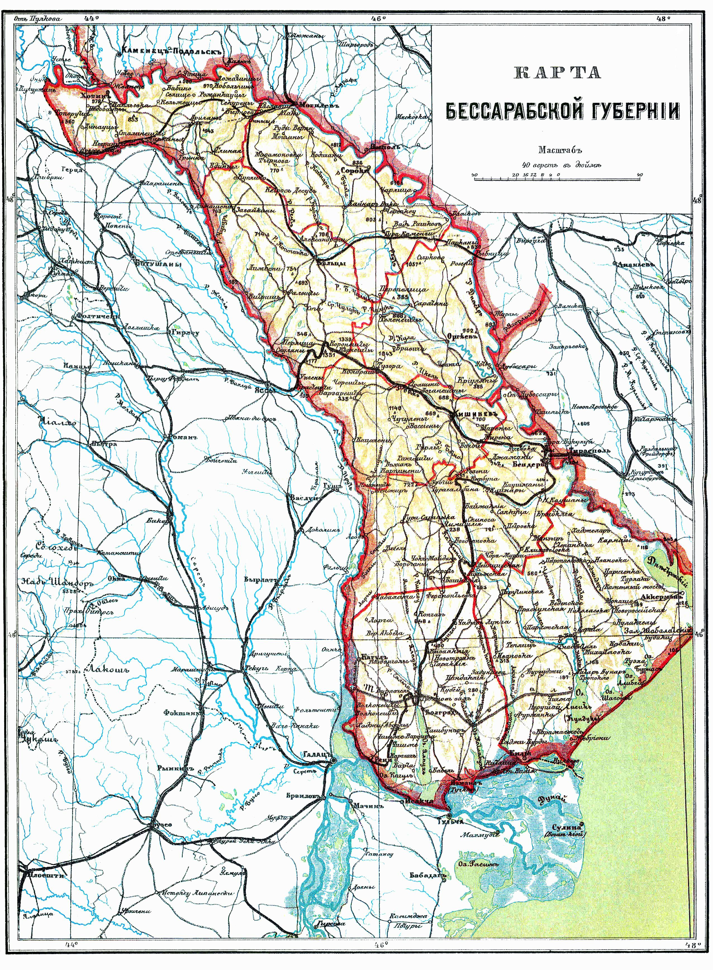

Slide 4
Executive summary
Six key points
1812 was a border revolution: the Prut became an imperial frontier and a new province called Bessarabia emerged under Russian rule.
Autonomy came first: from 1812 to 1828 the province kept Moldovan law, boyar influence, and Romanian in administration and justice.
Colonization changed the map: Russians, Ukrainians, Bulgarians, Gagauz, Germans, Jews, and others transformed the ethnic balance, especially in the south.
Russification was uneven: it was strongest among elites and institutions, weaker among the Moldovan peasantry.
The economy stayed agrarian: wheat, wine, and livestock mattered more than industry, and chronic rural poverty deepened social tensions.
Identity remained unsettled: by the early 20th century Bessarabia produced Romanophile activists, loyal imperial subjects, and many people who fit neither camp neatly.

Slide 5
Annexation
1812–1828: autonomy under Russian rule
New province
Boyar rule preserved
1818 statute
The Treaty of Bucharest transferred the lands between Prut and Dniester to Russia, and the whole area was renamed Bessarabia.
Alexander I confirmed one of the empire's highest levels of autonomy, with Romanian and Russian both used in administration and justice.
Tax exemptions, noble privileges, corporate estates, and local customs survived, letting native elites dominate the early provincial order.
This settlement depended heavily on pro-Russian boyars and on Metropolitan Gavril Bănulescu-Bodoni, who acted as a key intermediary with the imperial center.

Slide 6
Population
From Romanian majority to mixed frontier
0
86%
66.4%
47.6%
Population in 1817
Romanian in 1817
Romanian in 1858
Romanian in 1897
Moldovans/Romanians, 1817
86%
Moldovans/Romanians, 1858
66.4%
Moldovans/Romanians, 1897
47.6%
The decline did not mean Romanian disappeared; it meant colonization and urban concentration of minorities altered the demographic balance, especially in northern and southern districts.

Slide 7
Colonization
Who moved into Bessarabia
Group
Why they came
Where they concentrated
Notable effect
Russians & Ukrainians
Land, tax relief, frontier opportunity, military-admin settlement.
Especially south and in towns; Ukrainians strong in Hotin area.
Strengthened imperial control and changed the rural-urban balance.
Bulgarians & Gagauz
Orthodox refuge under Russian protection.
Southern Bessarabia, replacing expelled Tatars and Turks.
Created durable mixed colonies in the Bugeac.
Germans
Land, religious freedom, 50-year tax exemptions, loans.
Southern colonies founded from 1814 to 1824.
Highly productive agricultural settlements admired for order and wealth.
Jews
Pale of Settlement location and initially broader rights than elsewhere in Russia.
Towns and small market centers, but also countryside.
Dominated trade, milling, textiles, and much of urban economic life.

Slide 8
Autonomy lost
1828 brought centralization
Why autonomy ended
What changed
The 1821 upheavals in the principalities, the death of Bănulescu-Bodoni, renewed war with the Ottomans, and Governor Vorontsov's frustration with corruption pushed Russia toward tighter rule.
The governor gained power, noble influence narrowed, Russian administration expanded, and after 1833 Romanian ceased to function as a language of administration.
Even after 1828, Bessarabia remained unusual in some respects: serfdom was not reintroduced, old estate privileges survived, and military service was delayed until 1874. But the political logic had changed from negotiated autonomy to direct imperial control.

Slide 9
Language and church
Romanian flourished briefly, then was squeezed
Early gains
Administrative rollback
Church Russification
Bănulescu-Bodoni founded a seminary and press in Chişinău; Romanian religious publishing expanded, including a New Testament in 1817 and a full Bible in 1819.
Romanian ended as an administrative and school language in 1833, became marginal by 1854, and by 1867 no school in Bessarabia taught in Romanian.
From the 1840s to 1880s, higher posts went to Russians, Romanian worship was officially banned in 1870, and hundreds of churches were closed or pressured.
Yet the policy never fully succeeded: many churches still used Romanian or mixed liturgical forms, and lay religion often kept the vernacular alive better than the school system did.

Slide 10
Social outcomes
Russification hit classes differently
Group
Main effect
Result
Nobility & educated class
Russian schools, careers, imperial universities, mixed noble recruitment.
Large parts of the indigenous elite assimilated linguistically and culturally to Russian high society.
Peasantry
Too little schooling, too few teachers, short winter school years, weak access to books.
Not mass Russification, but mass illiteracy; in 1897 only 10.5% of Moldovan men and 1.7% of Moldovan women were literate.
Clergy & believers
Romanian displaced by Russian and Church Slavonic in worship and seminaries.
Alienation fed apathy, informal religion, and movements like that around the monk Inochentie.

Slide 11
Economy
Agricultural wealth, structural weakness
What Bessarabia produced
What it lacked
Why poverty endured
Industry remained tiny: only about 30,000 industrial workers by 1900, with 90% of industry tied to food processing.
Landlessness, droughts, tax burdens, absentee landlords, and weak infrastructure kept the countryside vulnerable to famine and unrest.
Grain, fruit, vegetables, wine, wool, and tobacco dominated exports; by 1900 wheat output was nearly double the Russian average.
Railways and telegraph links integrated Bessarabia into the empire, but the tsarist state still treated it more as a strategic frontier granary than as a region to industrialize.

Slide 12
Chişinău
From frontier town to provincial capital
Urban growth
Jewish city
Chişinău became the capital in 1818, was reorganized on a modern plan in 1834, and by the 1900s had roughly 125,000 inhabitants and major civic architecture.
By 1897 about half the city's population was Jewish, and by 1900 Chişinău had around forty synagogues, reflecting the centrality of Jewish urban life.
Pushkin had once mocked Chişinău as a miserable exile town, but later governors described a city of parks, cathedrals, trams, paved streets, and public buildings shaped by 19th-century imperial urbanism.

Slide 13
1903
The Chişinău pogrom
50
2
1903
Deaths
Days of violence
Global turning point
Antisemitic propaganda, ritual-murder accusations, and police passivity or complicity fed the Easter pogrom.
The event shocked world opinion and helped normalize the Russian word “pogrom” in international reporting.
It also energized Jewish self-defense thinking, Zionist activism, and Hayim Nahman Bialik's iconic poetic response.

Slide 14
Identity
Moldovan, Romanian, Russian?
Peasant continuity
Romanophile activists
Hybrid loyalties
Military service, church practice, and imperial schooling also created strong attachments to Russian institutions and a distinctive Bessarabian Orthodoxy.
Most villagers kept speaking Romanian in daily life, but this did not automatically produce a modern Romanian national consciousness.
Ion Pelivan, Pantelimon Halippa, Hasdeu, and Constantin Stere linked Bessarabia to Romanian cultural and political currents.
The chapter's wider lesson is that identity in late imperial Bessarabia was layered, contingent, and politically unresolved right up to 1918.

Slide 15
🏛️
conclusions
An imperial frontier,
a changing society
Russian rule reoriented Bessarabia politically and demographically, but it never fully solved the province's language question or identity question. That unresolved tension helps explain why the centenary celebrations of 1912 and the crisis of 1917–1918 carried such explosive force.

