Slide 1
Igor Cașu, Agenția Națională a Arhivelor/Facultatea de Istorie și Filozofie, Universitatea de Stat
MOLDAVIA/MOLDOVA UNDER OTTOMAN, TSARIST AND SOVIET EMPIRES. Commonalities, specificities, and consequences.
Core argument: Moldavia remained a tributary principality rather than an Ottoman province. The Porte controlled appointments and obligations, but local law, church, and institutions survived until the Russian-protected settlement of 1829.

Slide 2
📜
Tributary, not Subject
The Principality of Moldavia
under Ottoman Rule, mid 15th c.-mid 19th c.
Vassalage terms, tribute, hospodar appointments, autonomy, diplomacy, and the treaties that reshaped Moldavia's status.
Core argument: Moldavia remained a tributary principality rather than an Ottoman province. The Porte controlled appointments and obligations, but local law, church, and institutions survived until the Russian-protected settlement of 1829.

Slide 3
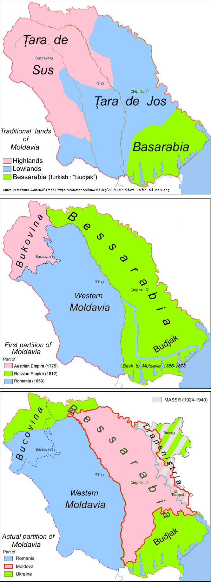

Slide 4
structure
01
02
Political framework
Tribute and offices
Why Moldavia was a vassal state, not an eyalet, and how suzerainty worked in practice.
The haraç trajectory and the shift from native dynasts to Phanariot appointments.
03
04
Autonomy and burdens
Treaties and legacy
Internal law, church life, military service, provisioning, and limits on diplomacy.
Küçük Kaynarca, Akkerman, Adrianople, and the road toward the post-1829 order.

Slide 5
Executive summary
Five takeaways
Not annexed: Moldavia stood under Ottoman suzerainty from 1538 to 1829 without becoming a regular Ottoman province.
Autonomy survived: Orthodox religion, boyar institutions, and indigenous legal codes persisted under Ottoman supremacy.
Tribute escalated: Annual payments grew from 2,000 ducats in 1456 to around 1,000,000 piastres by about 1820.
1711 changed rule: Cantemir's defection ushered in the Phanariot era of short, purchased appointments.
1774–1829 reset power: Russia gained leverage, tribute was fixed, and Adrianople formalized a new protected order.

Slide 6
Timeline
Five phases, 1538–1829
Suleiman I deposed Petru Rareş, fixed tribute, and strengthened Ottoman control
over princely selection.
Submission consolidated
Native dynasts still ruled, but wars with Polish, Cossack, and Habsburg actors kept the principalities exposed.
Native princes
After Stănileşti (1711), Nicolae Mavrocordat became the first Phanariot prince and office turnover accelerated.
Phanariot regime
Küçük Kaynarca opened the era of Russian intercession, repeated occupation, and the 1812 loss of Bessarabia, eastern half of the Principality of Moldavia.
Russian leverage
Native princes returned in 1822, then Adrianople in 1829 fixed tribute, lifetime election, and wider autonomy.
Native restoration

Slide 7
Tribute
Haraç grew, then froze
1456 Moldavia
c. 1820 Moldavia
c. 1820 Wallachia
1456 baseline
2,000 ducats
1714 Moldavia
65,000 piastres + gifts
c. 1820 Moldavia
1,000,000 piastres
c. 1820 Wallachia
2,000,000 piastres
Real pressure peaked in the late 16th century and again in the Phanariot age, when investiture gifts could outweigh the formal annual tribute.

Slide 8
Appointments
Native era vs Phanariot era
Dimension
Native era (1538–1711)
Phanariot era (1711–1821)
Candidate pool
Native Moldavian families such as Movilă, Rareş, Lăpuşneanu, Lupu, and Cantemir.
Greek Phanariot families including Mavrocordat, Ghica, Callimachi, Moruzi, and Suțu.
Selection
Boyar election with sultanic confirmation by berat; Ottoman intervention rose over time.
Direct sultanic appointment, effectively tied to competition and payments at the Porte.
Average reign
Roughly 5–7 years, with long outliers like Vasile Lupu.
About 2.5 years, with repeated transfers and recalls.
Cost of office
Moderate gifts and tribute.
Heavy peşkeş and borrowing from Greek bankers, repaid through office sales and taxation.
End of reign
Death, invasion, rebellion, or deposition.
Usually recall, transfer, or dismissal from Istanbul.

Slide 9
Comparison
Moldavia and Wallachia
Dimension
Moldavia (Boğdan)
Wallachia (Eflak)
Submission
Tribute began in 1455–56; direct Porte suzerainty fixed in 1538.
Submission dated to 1417, consolidated in 1462.
Tribute c. 1820
1,000,000 piastres per year.
2,000,000 piastres per year, about double Moldavia.
Capital
Iaşi, after earlier Suceava.
Bucharest, after earlier Târgovişte.
Ottoman districts
Hotin, Bender, Akkerman, Chilia, and border Brăila affected Moldavian space.
Turnu, Giurgiu, and Brăila pressed directly on the lower Danube frontier.
Loss under report period
Bessarabia went to Russia in 1812.
Oltenia was under Habsburg rule from 1718 to 1739.
After 1829
Native prince for life under Russian protectorate.
Parallel settlement, with Regulamentul Organic following in 1832.

Slide 10
Autonomy and burdens
What the Porte controlled—and what it did not
Military service
Diplomacy
Internal autonomy
Princes were formally barred from independent foreign policy, but they still kept covert channels with Poland, the Habsburgs, and especially Russia.
Moldavia supplied auxiliaries, labor, grain, sheep, timber, and transport. At Vienna in 1683, Moldavian troops numbered about 10,000.
Orthodox Christianity, boyar councils, and legal codes like Vasile Lupu's 1646 code endured. Ottoman law also forbade Muslim settlement and mosque construction in core Moldavia.

Slide 11
Treaty sequence
1774–1829 narrowed Ottoman discretion
Küçük Kaynarca, 1774
Returned Moldavia and Wallachia to Ottoman sovereignty, granted a two-year tax exemption, and recognized a Russian right to intervene on behalf of the principalities.
Akkerman, 1826
Fixed tribute at the 1802 level, kept it invariable, and established an election procedure for hospodars from native boyars.
Adrianople, 1829
Confirmed religion, security, administration, and trade freedoms; introduced lifetime native princes and ended the grain monopoly framework.

Slide 12
Debate
The “Capitulations” problem
Iorga
Revisionists
Maxim & Panaite
Read the capitulations as authentic bilateral treaties that permanently guaranteed Romanian autonomy.
Argued no Ottoman archival original survives and treated the texts as later reconstructions.
Accepted the texts as late, but showed that authentic firmans preserved the same substantive autonomy in practice.
The result: the legal mythologizing was later, but the principality's exceptional status was real.

Slide 13
🏛️
conclusions
Moldavia paid tribute,
but kept internal autonomy.
From 1538 to 1829, Ottoman power shaped succession, taxes, and military obligations; yet Moldavia remained institutionally distinct enough that later treaties could expand, not invent, its autonomy.

