Slide 1
Needs and Resources of Decoloniality in Romania and Moldova
ovidiu tichindeleanu
Decolonising Cultures of Remembrance
Chisinau, 30.04.2026

Slide 2
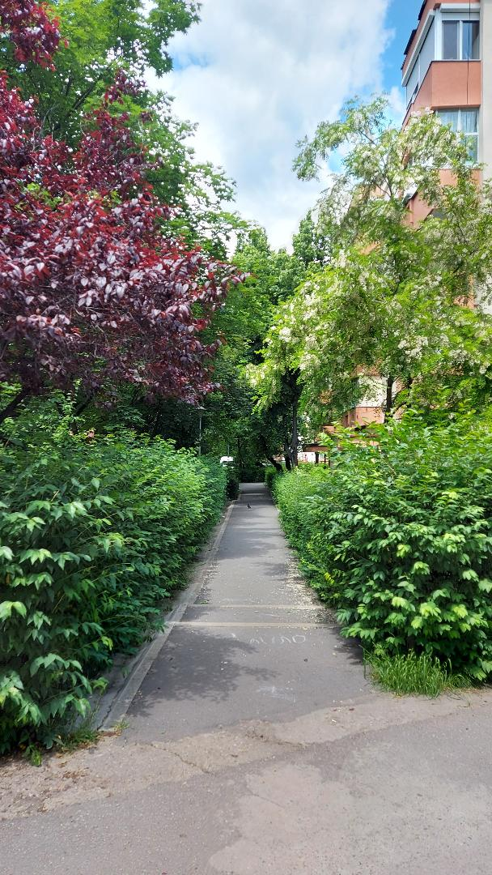

Slide 3
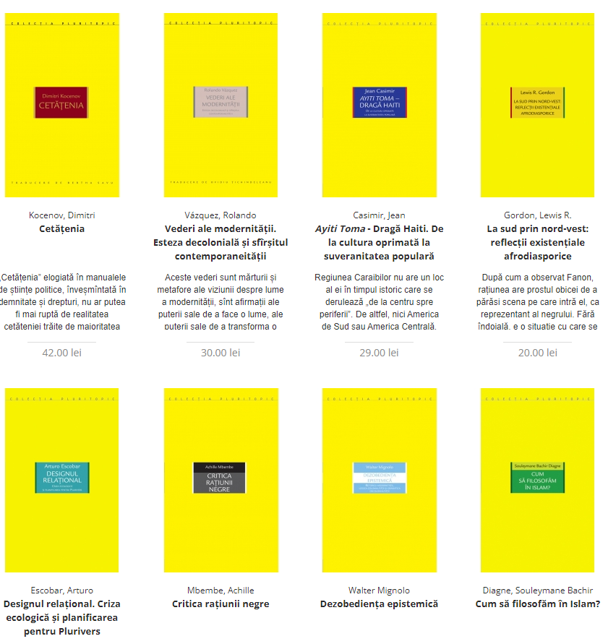

Slide 4
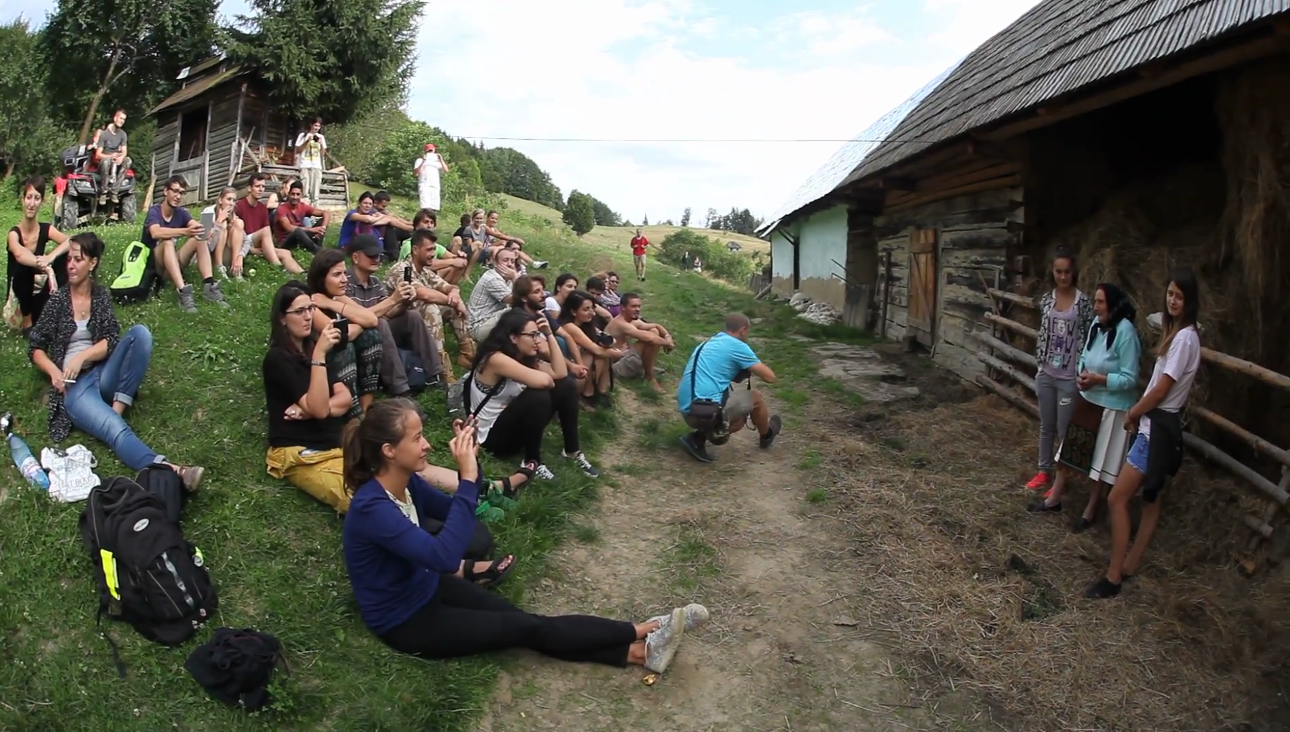

Slide 5
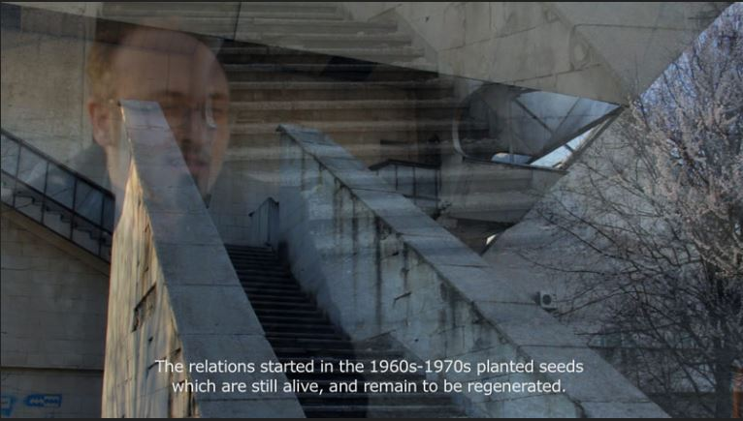
Mona Vatamanu, Florin Tudor, Gagarin’s Tree (2016)
https://monavatamanuflorintudor.ro/gagarinstree.htm

Slide 6
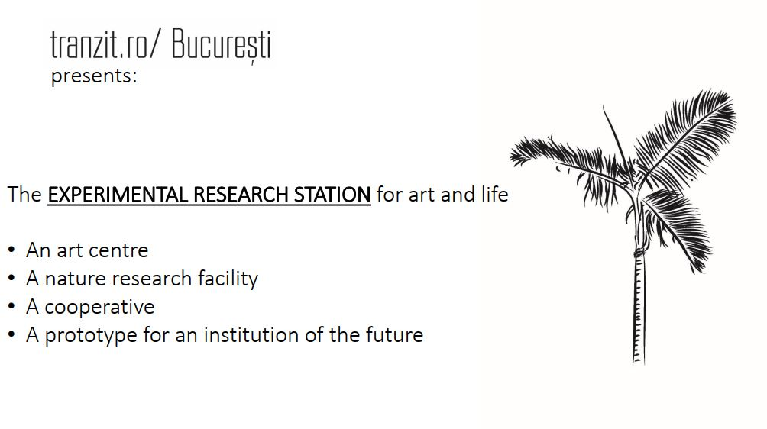
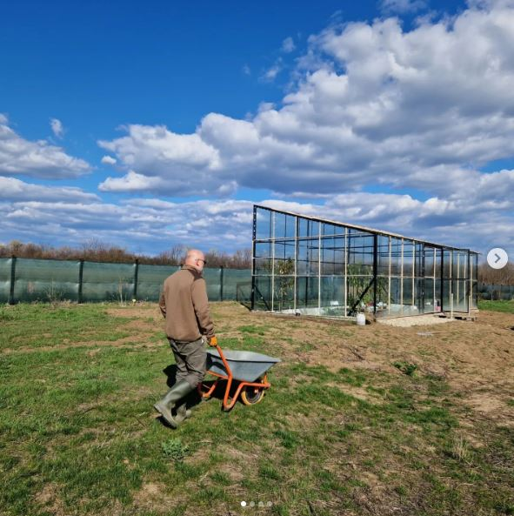

Slide 7
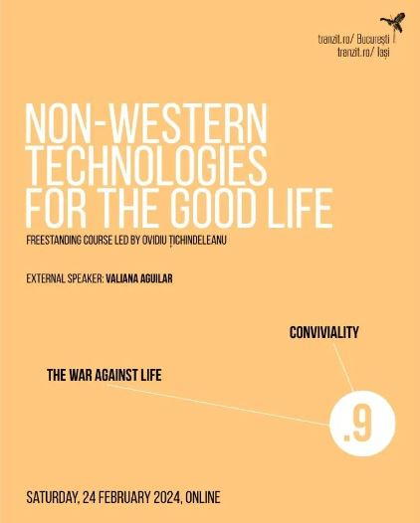

Slide 8
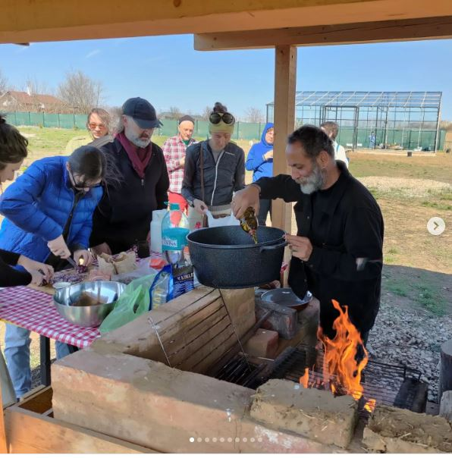
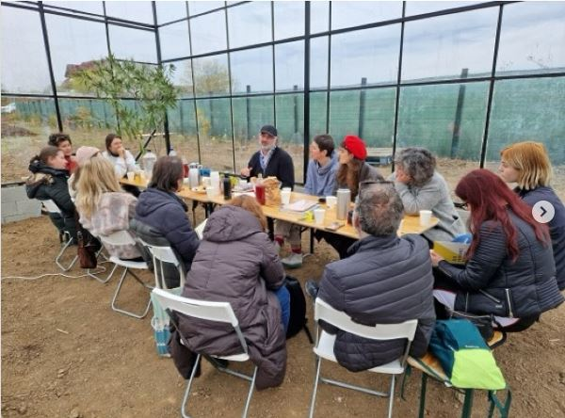

Slide 9
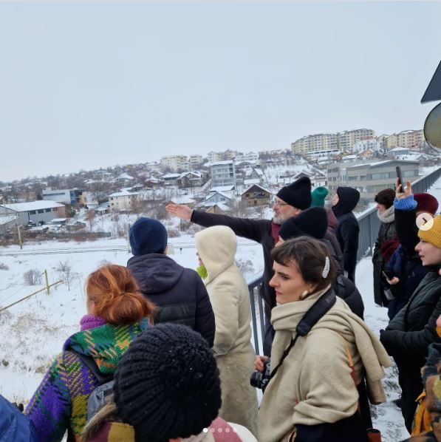
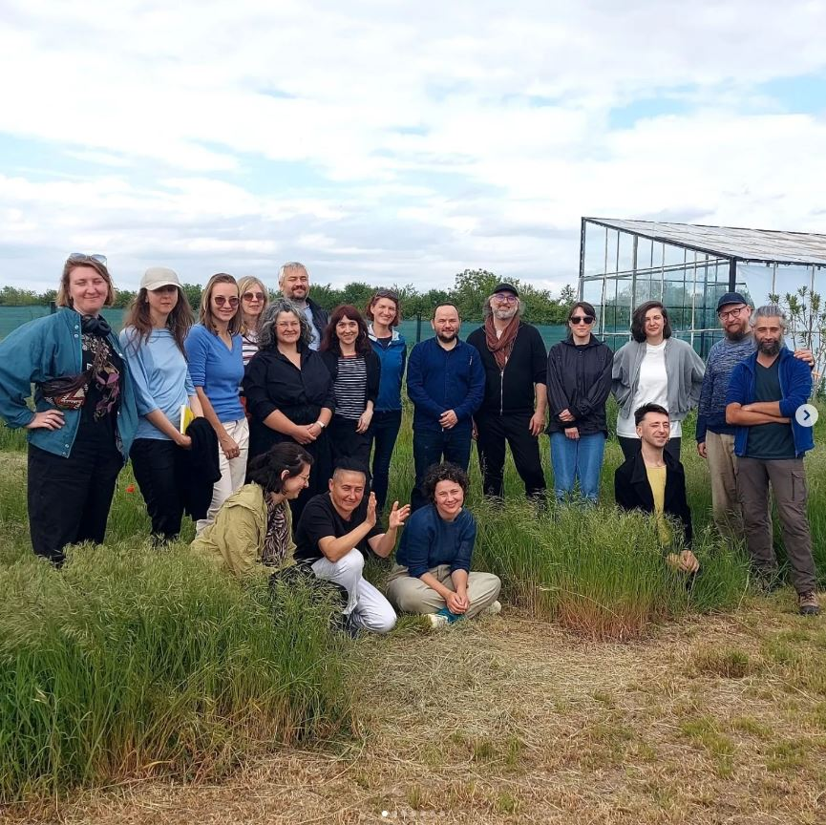

Slide 10
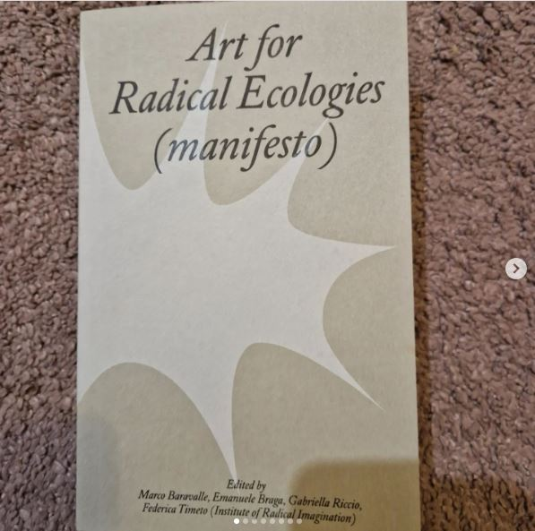
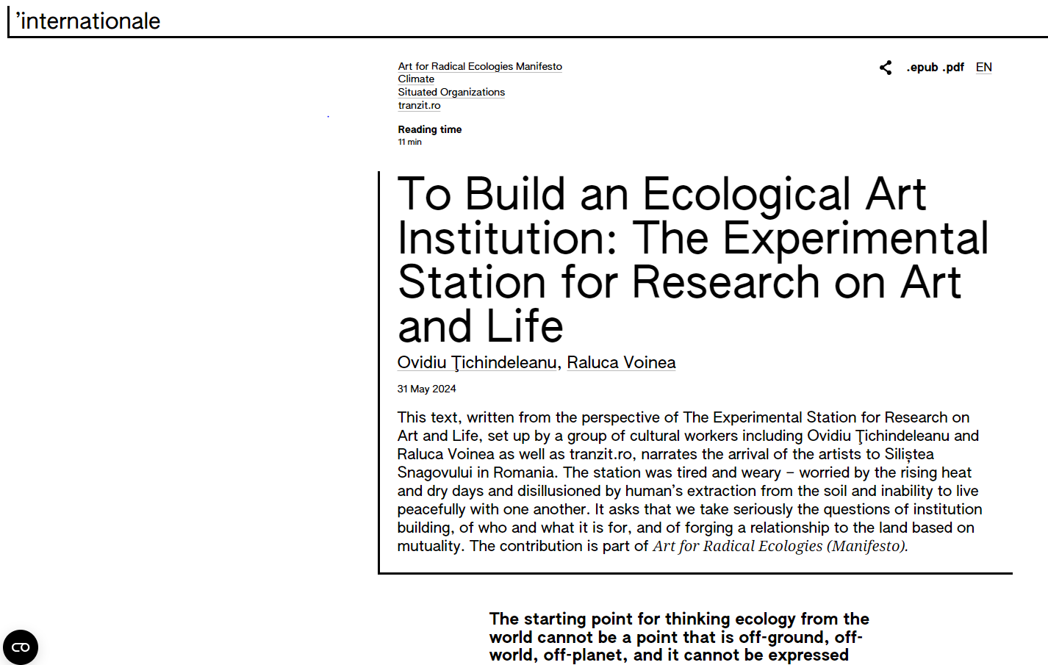

Slide 11
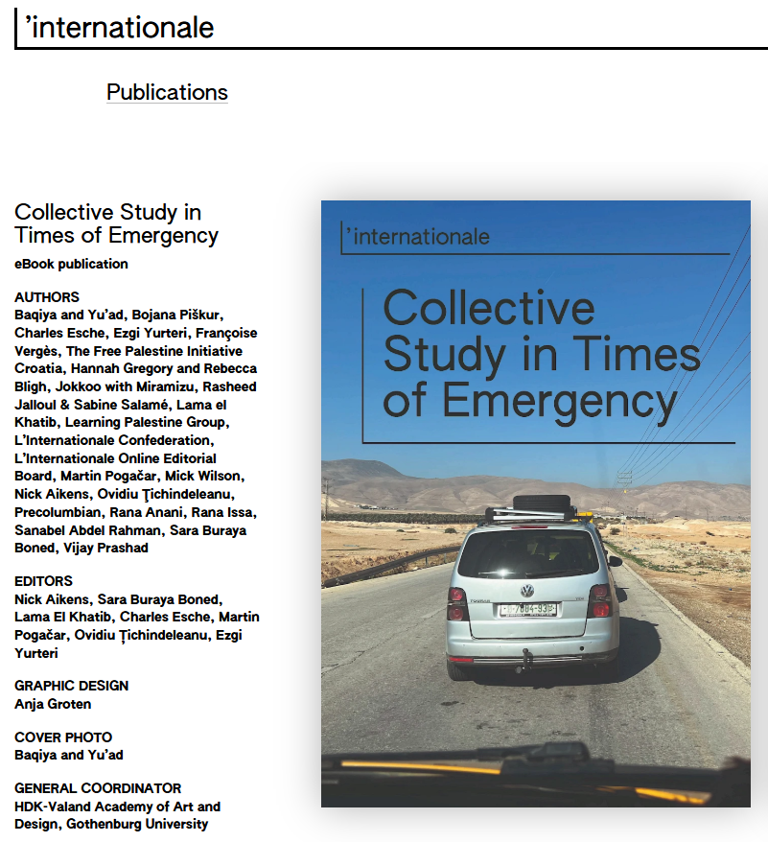

Slide 12
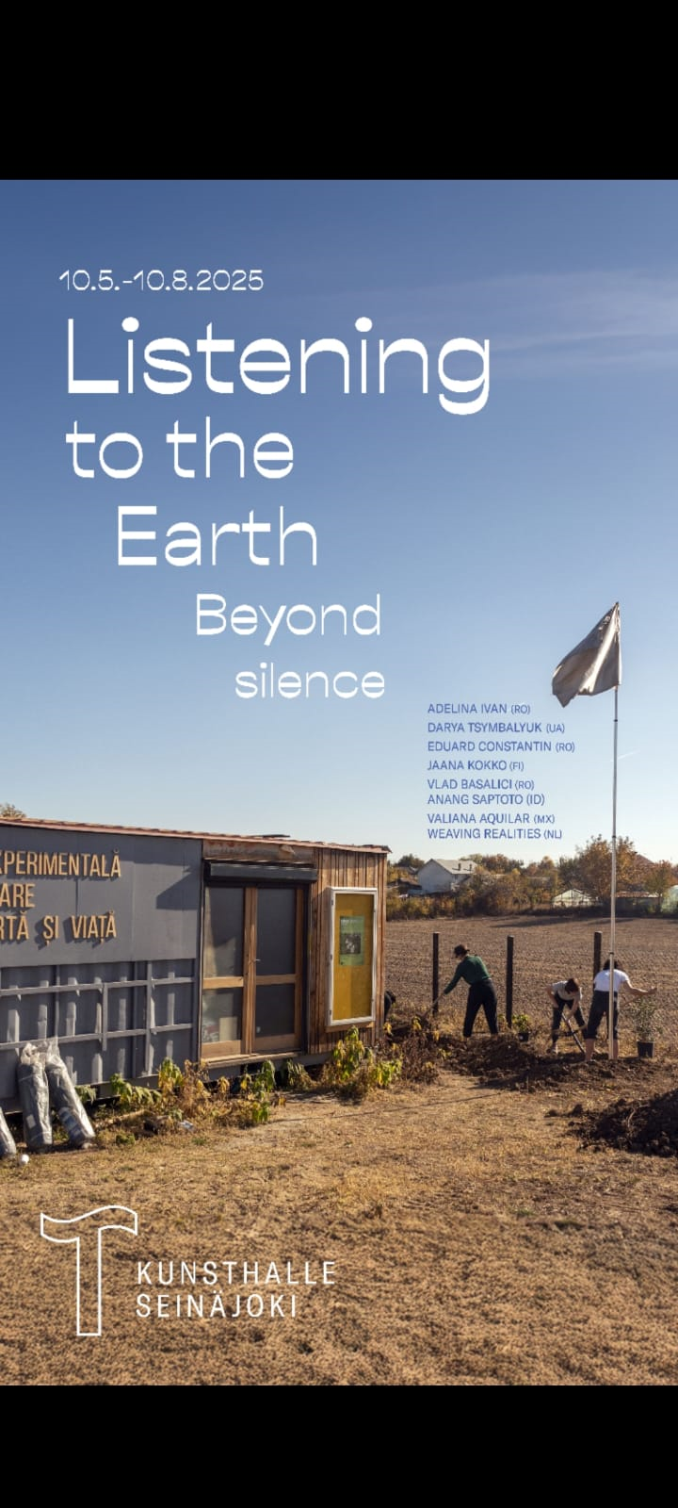

Slide 13
Meeting at the Horizon
How to [missing words] with wounds, anger, apathy, cruelty, indifference?...
How to negotiate sensibly the relation with radically different trajectories and knowledges (indigenous, regional, past, shattered…)?
Maria Lugones: the principle of “overcoming separation without distortion”: coming into the “I-We”.
Necessitates a decolonial re-orientation of sensibilities, relearning to perceive and recognize the original complexity of the other’s mark.
The principle of meeting at the horizon: not by territorial invasion; no need to look for a “better” or “more real” self, for an “authentic experience” or immersion. The sense of the world does not need to be global.

Slide 14
  THE CULTURAL ARCHIVE (Edward Said 1993)
  „Imperialism lingers in a kind of general cultural sphere as well as in specific political, ideological, economic and social practices“.
  „notions that certain territories and people require and beseech domination, as well as forms of knowledge affiliated with domination“: authority, development, dependency, integration.
  „the meaning of the imperial past has entered the reality of hundreds of millions of people, where its existence as shared memory and as a highly conflictual texture of culture, ideology, and policy still exercises tremendous force“.
  „[English] literature itself makes constant references to itself as somehow participating in Europe‘s overseas expansion, and therefore creates what Raymond Williams calls ‚structures of feeling‘ that support, elavorate, and consolidate the practice of empire... The supposed autonomy of works of art enjoins a separation which is a limitation“.

Slide 15
  POSITIONALITY: THE TASK OF GROUNDING
  ACROSS DISPLACEMENTS
  COALITIONAL THOUGHT: THE TASK OF CONNECTING
  ACROSS DIFFERENCES
  EPISTEMIC RENEWAL: THE TASK OF RE-ORIENTING SENSIBILITIES
  MAKING SENSE OF THE WORLD
  SELF-ARCHIVING
  REVALUING CULTURE
  ETHICAL ORIENTATION: against the war on life, social injustice, historical erasure, brutality, racialization, capitalism, coloniality, self-colonization, diminishment, destruction

Slide 16
  Where Are We, When We Think in Eastern Europe?
  When Are We, When We Think in Eastern Europe?
  With Whom Are We, When We Think in Eastern Europe?
  What Is Our Cultural Arhive?
  How to Walk an Ethical Life?

Slide 17
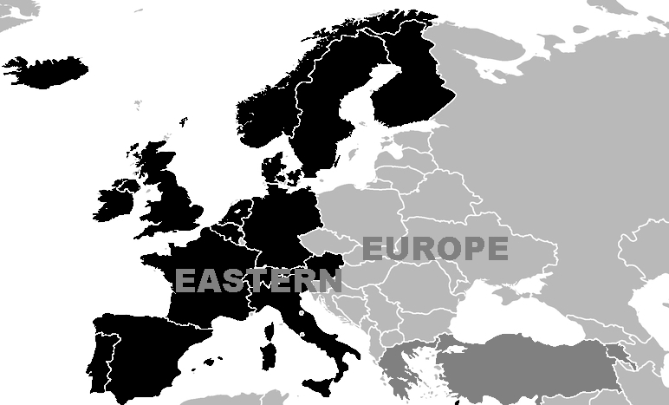

Slide 18
  “On one hand, there is the final peace, which arrives after the bombs will have shut everybody’s eyes. On the other hand, there is the daily peace, needed by people to breathe freely, as long as they can see. There are forces fighting for the final peace, and then there are forces committed for the daily peace”.
  (Franz Hodjak, “Eu cred în viaţă şi nu în cărţi”, in Miko Ervin (ed.), Întîlnire cu anul 2000, Cluj, Editura Dacia, 1989. The Veil of Peace, tranzit.ro/Bucharest,9 July 2017).

Slide 19
  FOUR HISTORICAL ANCHORS OF DECOLONIALITY IN CEE
  After 1989
  Socialism
  Colonial Modernity
  The Deep Past

Slide 20
  FOUR HISTORICAL ANCHORS
  After 1989: The Transition to Capitalism and Liberal Democracy

Slide 21
  FOUR HISTORICAL ANCHORS
  RELATING DECOLONIALLY TO EASTERN EUROPE
  After 1989: The Transition to Capitalism and Liberal Democracy
  Eurocentrism - Anticommunism - Capitalocentrism
  War
  De-Industrialisation
  Devaluation
  Self-Colonization
  Historical Erasure / De-Futuring
  Mass Migration
  Post-Communist Racism
  Religious Dogmatism
  Re-Internationalization through Western Institutions
  War
  Massive FDI
  GDP Growth

Slide 22
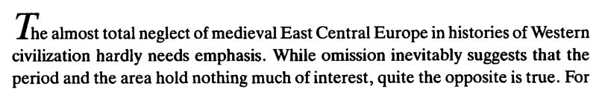
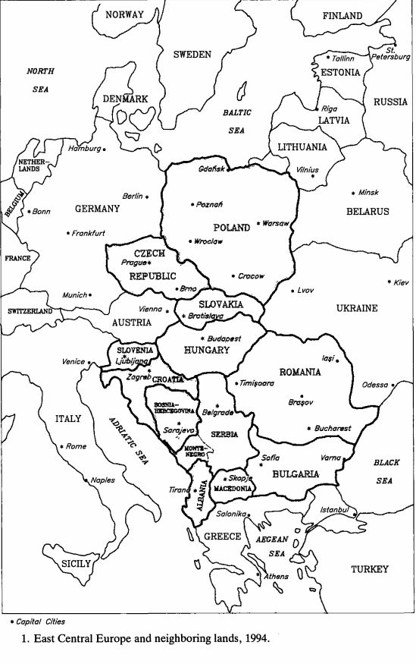
Jean W. Sedlar, East Central Europe in the Middle Ages 1000-1500 (1994)

Slide 23
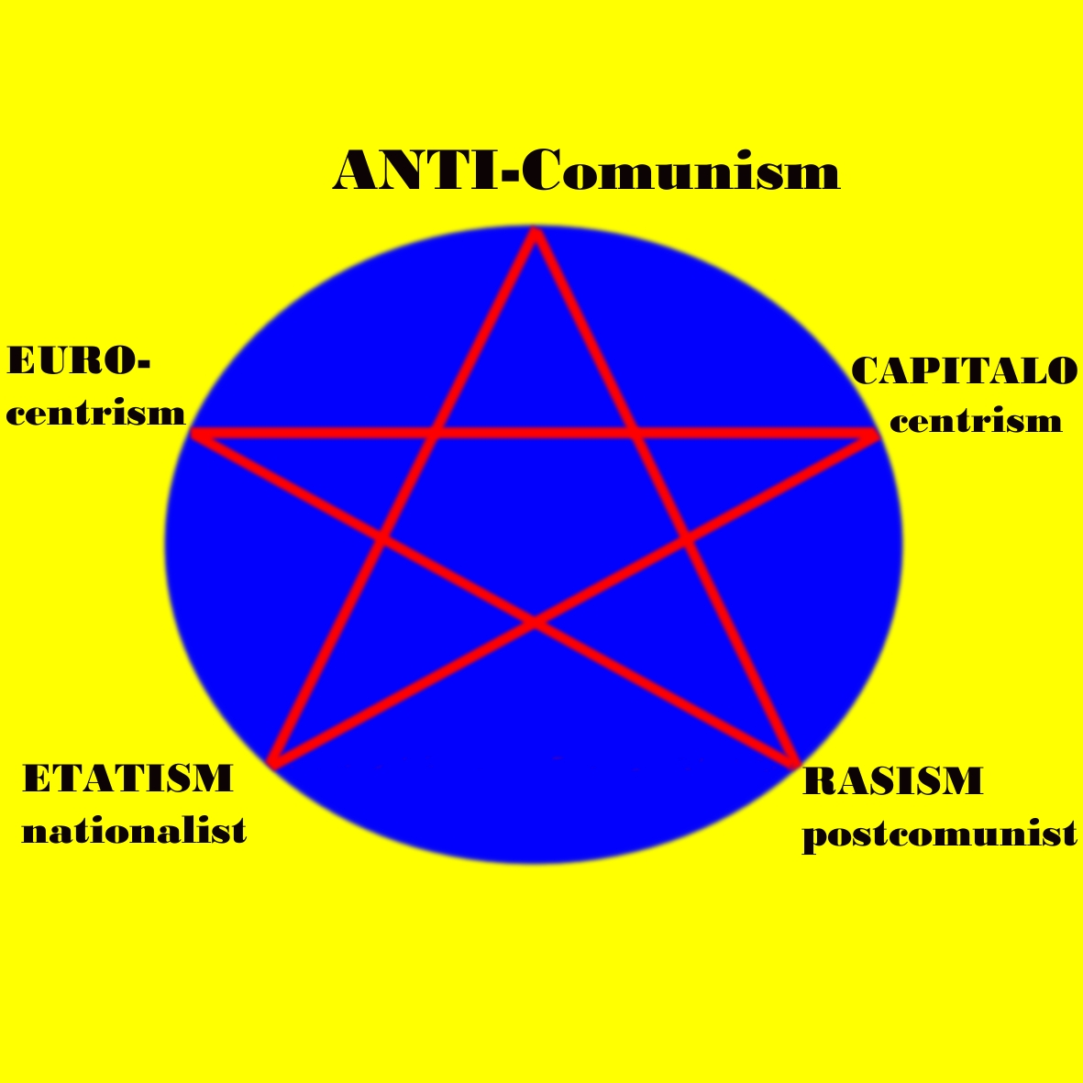

Slide 24
The Western Concept of Transition
Transition has been the dominant operative concept giving the direction of the systemic, paradigmatic changes followed in Central and Eastern Europe after 1989, from the “bankruptcy” and “crimes” of state communism towards the “normalcy” of Western liberal democracy and capitalism (cf. Jeffrey Sachs).
Wilhelm von Humboldt, talking about the “Greek miracle“ while the Atlantic Slave Trade was still going on (1781): "The free man served by a slave had leisure for athletics, the arts and the sciences“; slavery was “an indispensable means of transition from savagery to civilisation“. Interpreted philosophically: the transition of humanity itself from a primitive or non-scientific cognition, based purely on sense perception, to a developed form of cognition (such as Plato's theory of Forms or Ideas). Such a transition requires sacrifice: the necessary sacrifice to be performed by the Other.

Slide 25
The City as Site of Aesthetic Re-Education
the neoliberal model of city development:
demolishing & covering the ruins of the socialist civilization +
temporary industrial parks +
IT +
festivals
the „creative“ semi-peripheral cities: festivalization
  instrument for branding the city
    logic of temporary materialization
    temporary jobs
    increased ease of mimicry and perceptual training
    infusion of Westerners (bodies, wallets, gazes) into the semi-periphery
    stirring the desire for modernity (Sarr)
    image-heavy

Slide 26
Post-Socialist Life of Second-Tier Cities
- deindustrialization
- devaluation
- major source of labor migration to the West
- social trauma
- shrinking cities
demographic gaps: 1/4 of the counties have a smaller population than the city of Iasi; entire counties – Covasna, Mehedinti, Tulcea, Ialomita – have less people than medium-size cities like Brasov; counties like Cluj, Iasi, Prahova have ca. 1.000.000 people
-> reproduction of inequalities

Slide 27
Post-Socialist Life of Second-Tier Cities
Parliamentary Elections 2024
PSD 22% (2.065.087 votes)
AUR 18% (1.694.705 votes)
PNL 14%
USR 12%
SOS Romania 7%
POT 6%
UDMR 6%

Slide 28
Aesthetic Categories of “Post-socialist” History:
The “After 1989”
from past to future
from behind the Iron Curtain to the Free World
from "bankruptcy" to “efficiency“
from communism to capitalism
from totalitarianism to democracy
from tyranny to freedom
from madness to normalcy
from backwardness to civilization
from East to West
OT, A Cultural History of the Transition to Capitalism

Slide 29
  FOUR HISTORICAL ANCHORS
  RELATING DECOLONIALLY TO EASTERN EUROPE
  Socialism

Slide 30
POLITICAL THEORY OF DECOLONIZATION
1954 Marcel Willard, Marşul
1954 S. M. Melman - Economia Indiei si politica imperialismului englez
1955 P. S. Romaskin - Crimele de razboi ale imperialismului
1958 Vladimir Ilici Lenin - Despre problema nationala si national-coloniala
1960 Vladimir Ilici Lenin - Imperialismul, stadiul cel mai inalt al capitalismului
1958 Kwame Nkrumah – Autobiografie. Mesaj din Ghana
1961 Gh. Badrus - Invatatura leninista despre imperialism si despre criza generala a capitalismului
1962 Gh. Badruş, Mişcarea de eliberare naţională
1965 Colin Legum, Pan-Africanism. A Short Political Guide
1960 Jacques Arnault - Procesul colonialismului (tr.)
1962 Friedrich Engels, Karl Marx - Despre sistemul colonial al capitalismului
1962 I. Anghel - Neocolonialismul. Fapte si teorii economice
1968 E. S. Sachs - Anatomia apartheidului (tr.)
1972, Radu Vasiliu, Decolonizarea şi relaţiile internaţionale
1974 Ion Aszody, Mercenarii iadului. File din istoria colonialismului
1977 Tendinţe actuale în structurile politice africane, Academia Ştefan Gheorghiu, Uz intern.
1979 Elena Voiculescu, Renaşterea africană, Editura Politică
1981 Politica agresiva si uneltirile imperialismului american impotriva Republicii Populare Romane
1981 Imperialismul, sistem de jefuire si exploatare a altor popoare
1982 Practici imperialiste de jaf si exploatare. Furtul creierelor. Dobanzi de tip neocolonialist
1982 Gîndirea politică africană, Editura Politică
1985 Fernand Braudel, Mediterana şi lumea mediterană în epoca lui Filip al II-lea (tr)
.

Slide 31
  FOUR HISTORICAL ANCHORS
  RELATING DECOLONIALLY TO EASTERN EUROPE
  Colonial Modernity
  Enslavement and Serfdom
  The Sugar and the Bread
  Imperial Differences

Slide 32
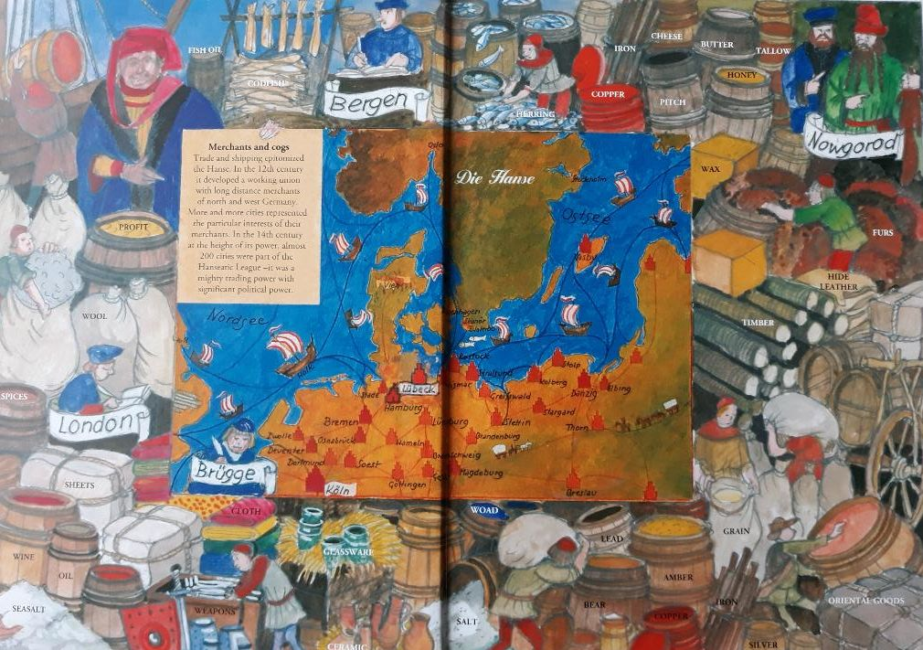

Slide 33
THE SUGAR AND THE BREAD
From the 1600s, “English” sugar displaced “Portuguese” sugar in the markets of northern Europe, and this was also a period of rapid English commercial expansion into the Baltics. The sugar produced in slave plantations in the Caribbean and brought mainly to England, France and Holland, becomes the leading commodity in a major re-export trade within Europe, towards its East.
In the same time, at around 1600, most of Western Europe is heavily dependent on Polish grain exports, which were expensive, costing 2-3 times their price of import.
The demand which sustained production in the capitalist slave-enterprises of the West Indies depended to some degree on the expansion of feudal incomes in the grain-exporting zones of Eastern Europe. The structure of world-exchanges linked the capitalist slave-plantations of the Atlantic to feudal estates in Poland through a complicated network of basically mercantile and financial interests centred in Amsterdam and London ” (Jairus Banaji,2010)

Slide 34
  FOUR HISTORICAL ANCHORS
  RELATING DECOLONIALLY TO EASTERN EUROPE
  The Deep Past
mostly rural civilization of villages (both pastoral and agricultural), based on stock raising, herding and farming, hunting, with the typical living unit being a household for the extended family (three generations), living off the fertile lands; woodlands, pastures, lakes etc. were held in common. Seasonal nomadism was common (communities of herders).
rural or peasant self-government is common throughout the region of Eastern Europe, from the Polish “opole” to the Valachian and Moldovan “obşte” (common council) and “sfatul batrinilor” (the council of old men) and the autonomous confederation of villages (“devalmasie”).

